Slide 1
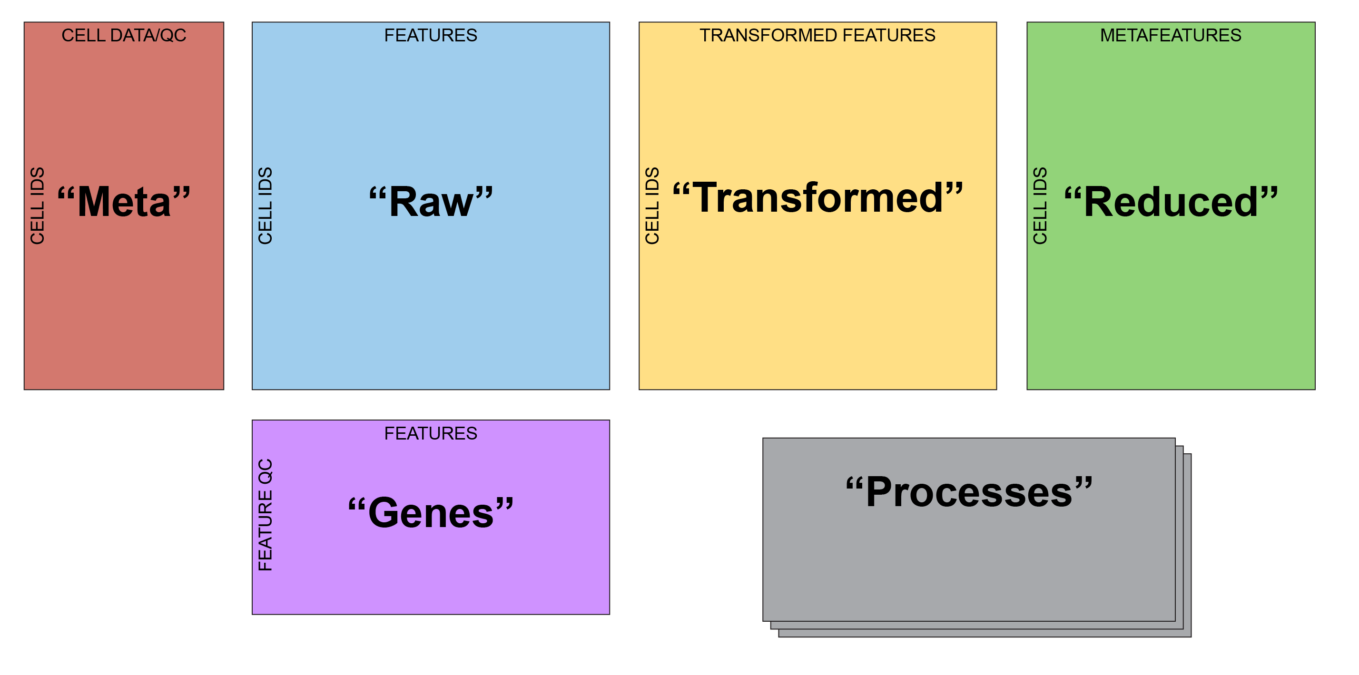
Single Cell Anatomy

Slide 2
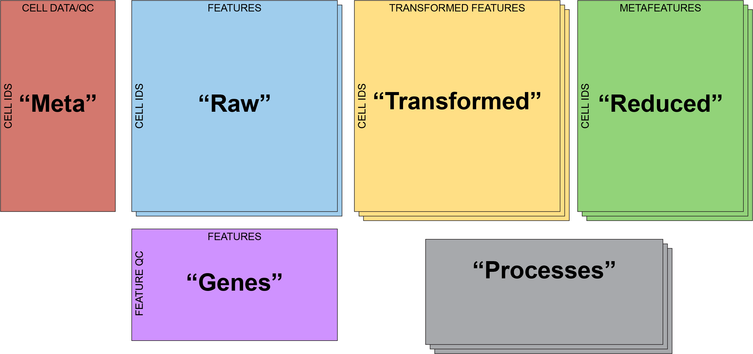
Single Cell Anatomy
“Dimensional Reductions”
“Layers”

Slide 3
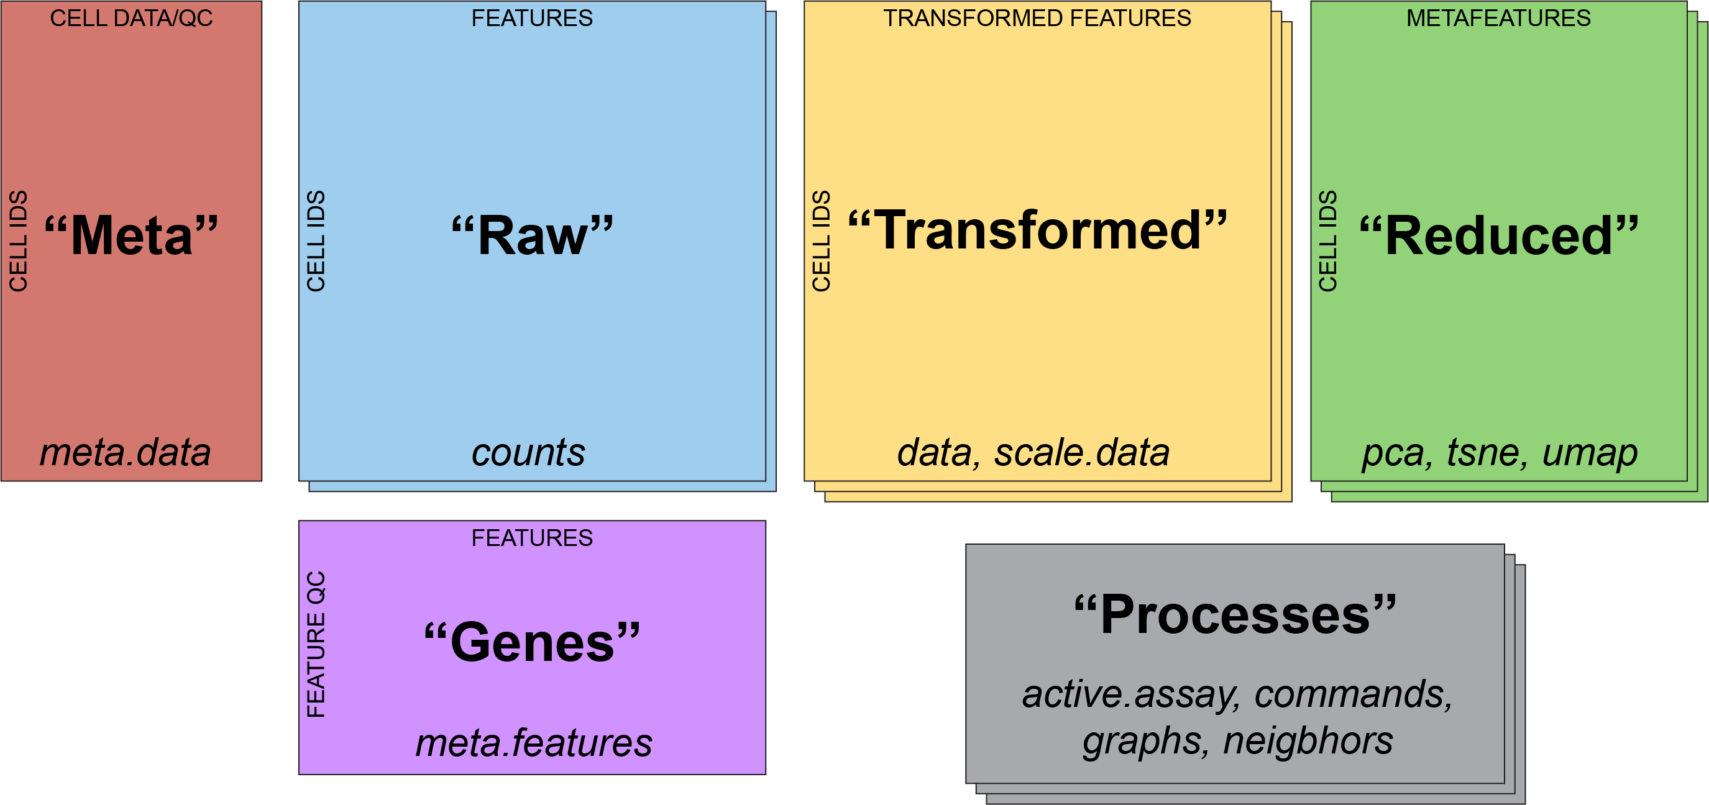
Single Cell Anatomy

Slide 4
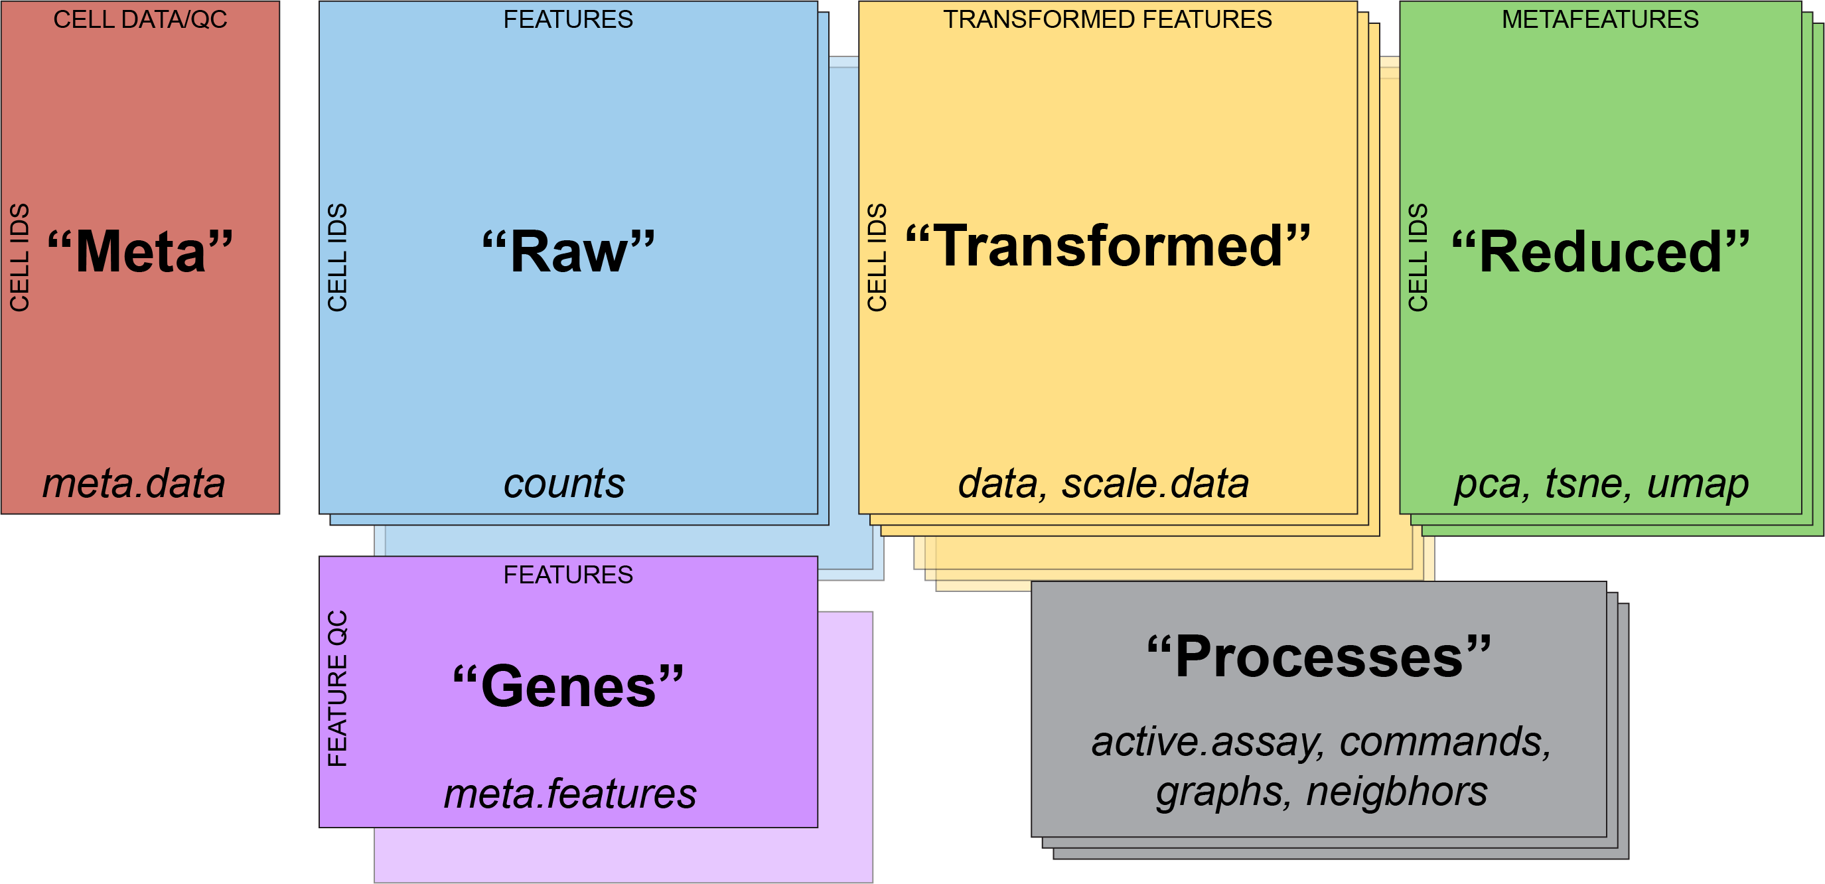
Single Cell Anatomy
“Assays”

Slide 5
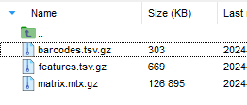
Visual Walkthrough
CreateSeuratObject()

Slide 6
Visual Walkthrough
NormalizeData()
“put all of the cells on the same playing field”
“depth normalization”

Slide 7
Visual Walkthrough
ScaleData()
“put all features on the same playing field”
“emphasize cell-to-cell variation”

Slide 8
Visual Walkthrough
RunPCA()
What will the rownames be in the new “pca” data frame?

Slide 15
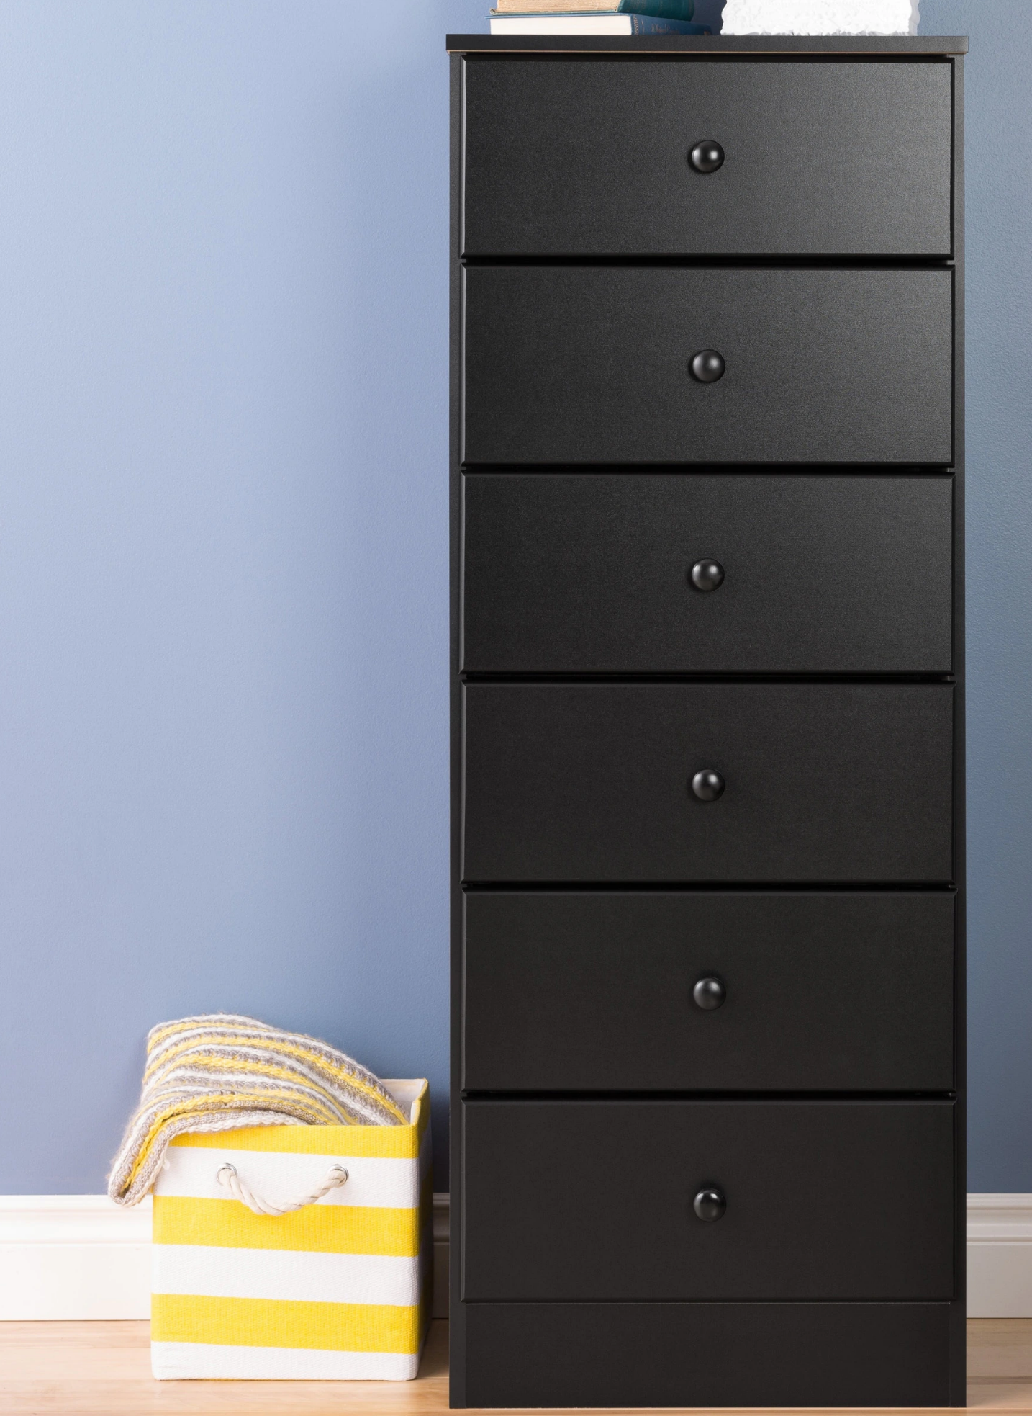
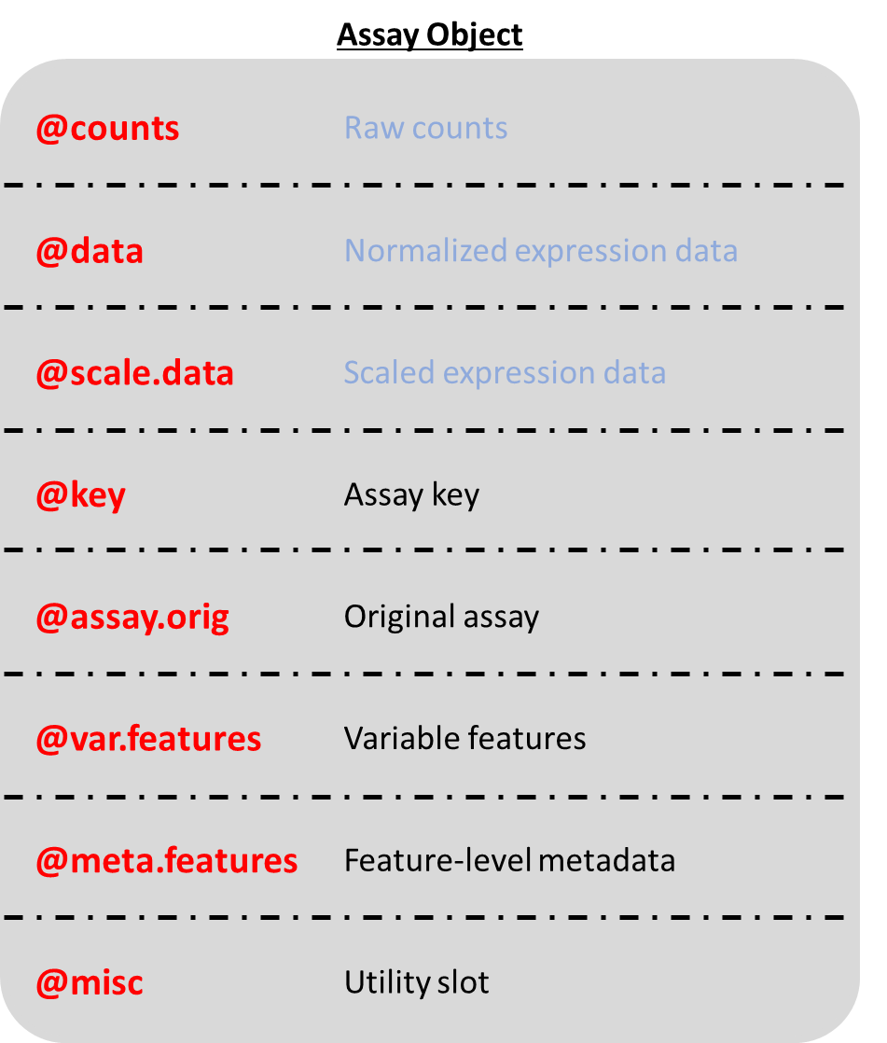
Seurat Object
@assays | List of assays
@meta.data | Dataframe
@active.assay | Active, or default, assay
@active.ident | Active cluster identity
@graphs | List of Graph objects
@neighbors | k.param nearest neighbors
@reductions | List of dim. red. objects
@images | List of spatial image objects
@project.name | Name of the project
@misc | List of miscellaneous information
@version | Seurat Version
@commands | List of commands run on this object
@tools | List of miscellaneous data

Slide 16
Seurat Object
Assay Object
@assays | List of assays
@meta.data | Dataframe
@active.assay | Active, or default, assay
@active.ident | Active cluster identity
@graphs | List of Graph objects
@neighbors | k.param nearest neighbors
@reductions | List of dim. red. objects
@images | List of spatial image objects
@project.name | Name of the project
@misc | List of miscellaneous information
@version | Seurat Version
@commands | List of commands run on this object
@tools | List of miscellaneous data
@counts | Raw counts
@data | Normalized expression data
@scale.data | Scaled expression data
@key | Assay key
@assay.orig | Original assay
@var.features | Variable features
@meta.features | Feature-level metadata
@misc | Utility slot

Slide 17
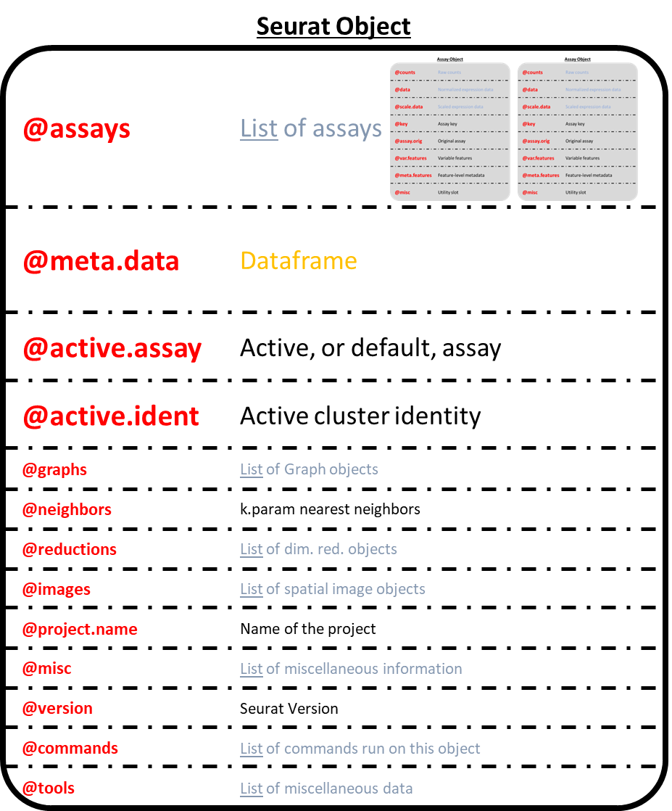
sobj@assays$RNA@counts
“sobj”
“RNA”

Slide 23
Assay Object
@counts | Raw counts
@data | Normalized expression data
@scale.data | Scaled expression data
@key | Assay key
@assay.orig | Original assay
@var.features | Variable features
@meta.features | Feature-level metadata
@misc | Utility slot
Assay <- setClass(
Class = 'Assay',
slots = c(
counts = 'AnyMatrix',
data = 'AnyMatrix',
scale.data = 'matrix',
key = 'character',
assay.orig = 'OptionalCharacter',
var.features = 'vector',
meta.features = 'data.frame',
misc = 'OptionalList'
)
)

Slide 24
Seurat Object
@assays | List of assays
@meta.data | Dataframe: metadata about each cell
@active.assay | Active, or default, assay
@active.ident | Active cluster identity
@graphs | List of Graph objects
@neighbors | k.param nearest neighbors
@reductions | List of dim. red. objects
@images | List of spatial image objects
@project.name | Name of the project
@misc | List of miscellaneous information
@version | Seurat Version
@commands | List of commands run on this object
@tools | List of miscellaneous data
Seurat <- setClass(
Class = 'Seurat',
slots = c(
assays = 'list',
meta.data = 'data.frame',
active.assay = 'character',
active.ident = 'factor',
graphs = 'list',
neighbors = 'list',
reductions = 'list',
images = 'list',
project.name = 'character',
misc = 'list',
version = 'package_version',
commands = 'list',
tools = 'list'
)
)

